Slide 1
Choosing the Right Road Permit for the Job
Brenda Christensen – R1 Transportation O & M Engineer
Leslie J. Boak – R5 Transportation Engineer

Slide 2

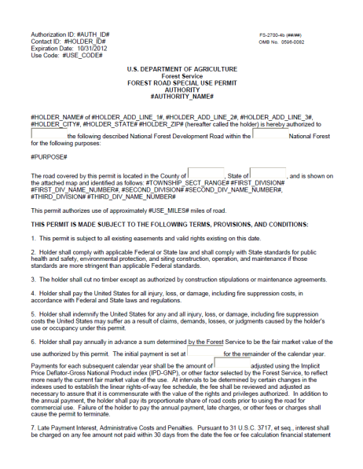
Choosing the Right Road Permit for the Job
What is a Permit
What are my options?
How do I know what type of permit to choose?
How does NEPA fit in?
Lands Road Use Permits and Easements
Engineering Road Use Permits

Slide 3
Purpose of the Road Permit
Definition of a Permit: “The permission by competent authority to do an act which, without such permission, would be illegal, a trespass or a tort.” Black’s Law Dictionary
Permits are revocable and are issued for a specific time period (terminable).
Permits are merely a license or privilege to do what otherwise would be unlawful on another’s land without holding any estate in the land.

Slide 4
Purpose of the Road Permit
Road Permits are used to authorize:
Commercial hauling or other uses that are restricted by an Order.
Use of motor vehicles that exceed State size and weight restrictions (Off-Highway Haul).
Use of motor vehicles that are not designated on the MVUM.
Perform road maintenance when the permitee desires a higher standard
Notes:
State load limits apply unless there is an order that changes the ratings.
Often done on bridges, sometimes on roads.
Over-size loads are also referred to as Off-Highway Haul.
Do not confuse this term with off-road motor vehicle use.
Any motorized use not designated on the MVUM must be authorized in writing.

Slide 5
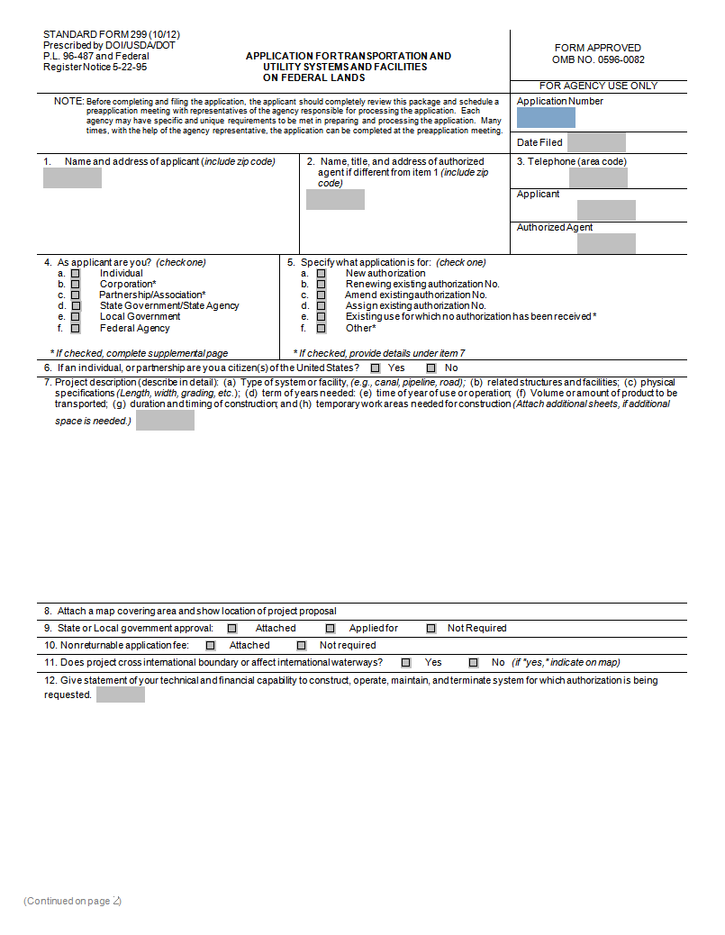
How do I know what type of permit to choose?
What is the need requested?
Application for Permit for use of Roads, Trails, or Areas Restricted by Regulation or Order FS 7700-40
Application for Transportation and Utility Systems and Facilities of Federal Lands SF 299
Ask Questions of the Applicant
Know what your Options Are

Slide 6
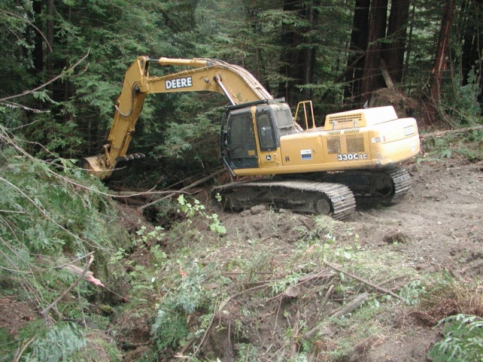
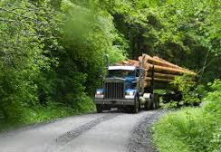
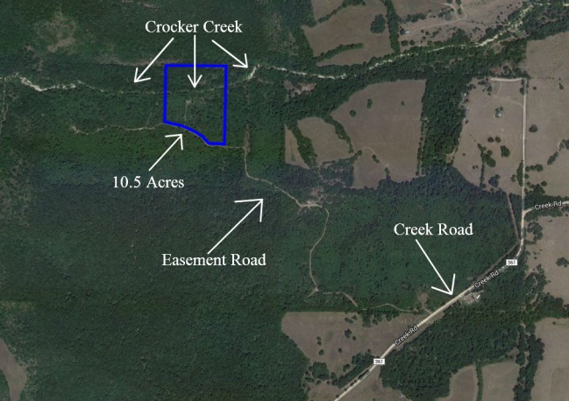
Types of Roads Special Use Permits and Authorizations Generated by Lands
FS-2700-4b
Forest Road Special Use Permit
FS-2400-4c
Private Road Special Use Permit
FRTA and FLPMA
Easements

Slide 7
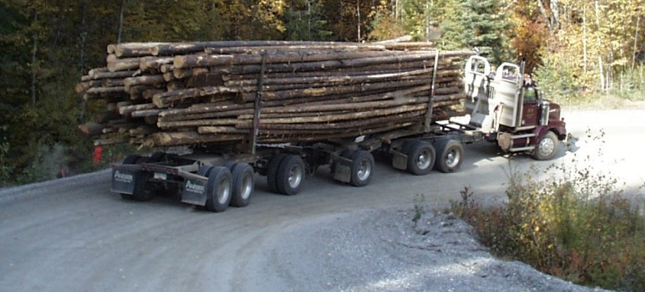
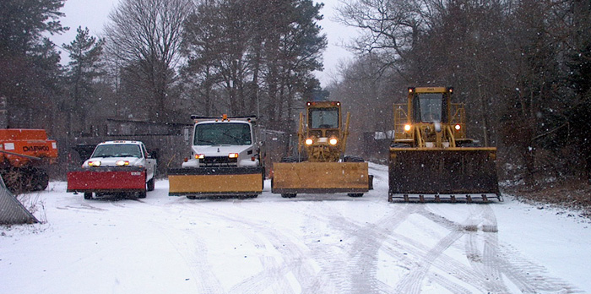

Types of Road Use Permits Generated by Engineering
FS-7700-41
Non-Federal Commercial Road Use Permit
FS-7700-48
Permit for Use of Roads, Trails, or Areas Restricted by Regulation or Order

Slide 8
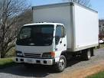
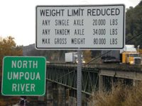
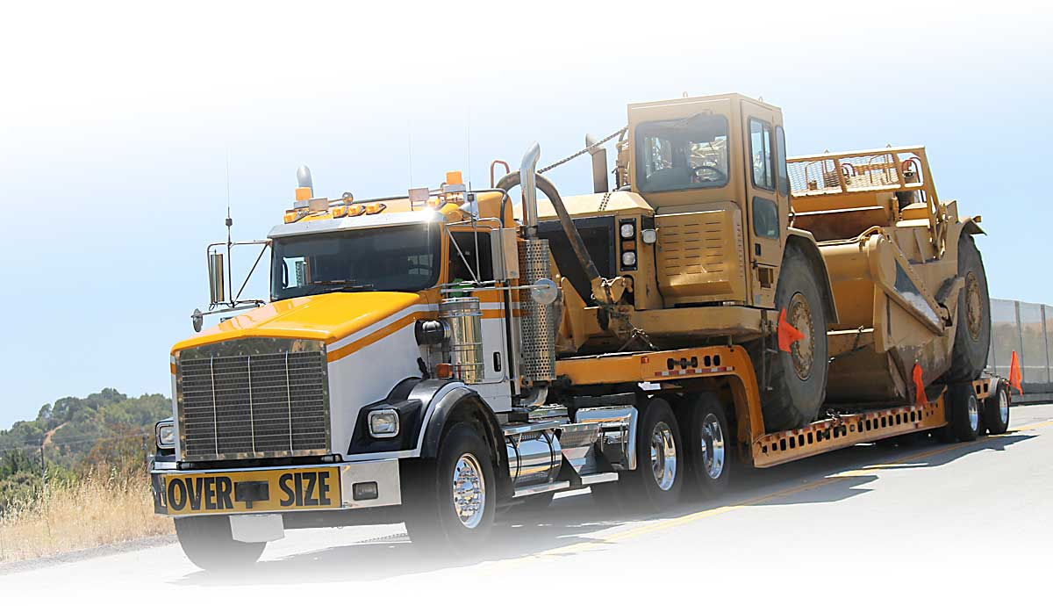
Types of Road Use Permits Generated by Engineering
Authorization Letter
For Simple Requests
Bridge Overweight Permits
Talk to Structures Group
Oversized Vehicle Permits
Can be done on a FS-7700-48

Slide 9
What Kind of Road Permit- Selection Chart
SCENARIO TIME

Slide 10
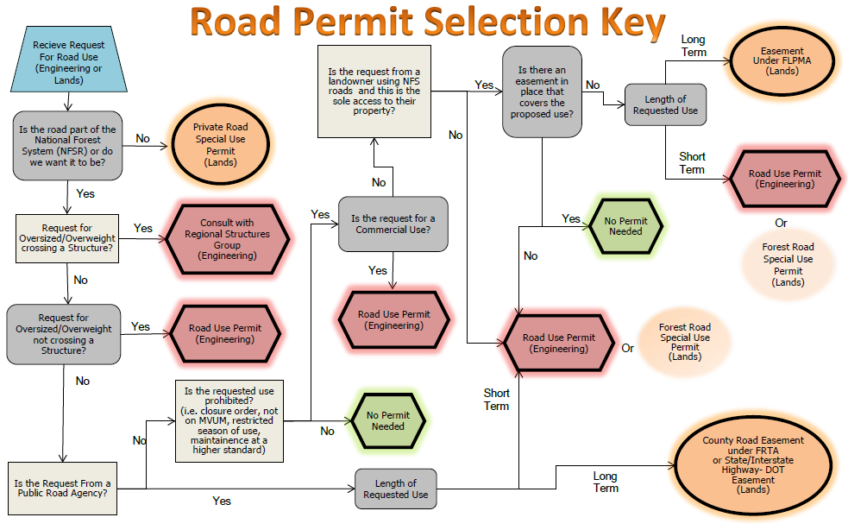

Slide 11
Scenario 1
A forest user has reserved a group campsite for a wedding. The NFS road is an objective maintenance level 3 open to the public but is currently operated as a maintenance level 2. The forest user would like to have the road bladed right before the wedding so the guests can drive their cars to the site.

Slide 12
Scenario 2
There is a piece of private land that is accessed from a NFS road. The NFS Road is currently open to the public and is at an objective and operational maintenance level 3. The owner plans to log 10 MBF. The two truckloads of logs will be hauled to mill over this NFS road.

Slide 13
Scenario 3
A privately owned parcel is accessed by two different NFS roads. One of the roads is open year road to the public and is the main access to his parcel. The other road has a seasonal closure on it from October 15th to Dec 30th. The owner needs to access the back side of his property to do some work on an old well in November. The best way to access the well is using the road with the seasonal closure.

Slide 14
Scenario 4
A piece of private land can only be accessed by crossing NFS Lands. The owner would like to build a road accessing his property.

Slide 15
Scenario 5
A private land owner has a Private Road Special Use Permit on the road accessing his property. He will be logging several acres over a 5 year period. The estimated timber volume is 100 MBF total. The haul route for all of the volume is on the road with the Private Road Special Use Permit then onto a NFS road before it reaches the county road.

Slide 16
Scenario 6
A cabin owner is going to build a deck. He is having 1 load of lumber being delivered. The delivery truck will have to use an NFS road.

Slide 17
Scenario 7
A property owner is building a deluxe cabin. All of the construction materials will be delivered to the property on a NFS road.

Slide 18
Scenario 8
A timber sale requires a yarder at the landing. The access route to the landing is via an NFS road with two bridge crossings.

Slide 19
Scenario 9
The local Boy Scout camp is hosting a school field trip. They have requested access to use a large school bus on a NFS road that accesses the camp.

Slide 20
Scenario 10
For access to a subdivision, the county as requested to take over maintenance of the road.

Slide 21
Scenario 11
A volunteer group would like to do maintenance on a NFS road leading to their favorite trail. The group would like to do road side brushing, logging out with chainsaws and filling in pot holes for a smoother ride.

Slide 22
NEPA
For Road Use Permits

Slide 23
NEPA
NOT REQUIRED on an existing open road if:
Use is already authorized under 36 CFR 212.6(b) & (c)
Permit is for governing maintenance and use
FSM 7731.17:
“Road use permits issued for use of NFS roads designated for motor vehicle use (other than when public use is restricted by a designation for motor vehicle use by time of year) are not subject to NEPA or ESA analysis because these roads are available for public use under 36 CFR 212.6(b) and (c).”
Notes:
So, The traffic and maintenance work on the road can be authorized without NEPA.
Reconstruction work, however, is subject to NEPA and complexity depends on scope.
Work such as widening, realignment, bridge replacement, etc. will require analysis and decision documentation.
Check with your NEPA specialists.

Slide 24
NEPA
IS REQUIRED when:
Public motorized traffic will be restricted during use by the permittee;
Use is on a road where motorized use is not designated;
Use is on a trail which will be converted to a road for the permit;
Snow removal will be authorized;
The road is to be reconstructed to a higher standard
Whenever the authorized use is in conflict with the MVUM designation.
(type of vehicle or time of year)

Slide 25
Types of Roads Special Use Permits and Authorizations Generated by Lands
FS-2700-4b
Forest Road Special Use Permit
FS-2400-4c
Private Road Special Use Permit
FRTA and FLPMA
Easements

Slide 26
Permits Generated By Lands
FS-2700-4b Forest Road Special Use Permit
Permits under FLPMA for the construction and use of National Forest System Roads typically to access private property within a national forest for commercial purposes such as the removal of forest products or other resources from non-Federal lands.
Preference is to issue a Road Use Permit under Engineering as it can be easily suspended for non-compliance with the terms and conditions. It is much harder to suspend a Forest Road Special Use authorization.
Notes:
Forest Road Special Use Permits
The Forest Road Special Use Permit is used to authorize, under FLPMA, the construction and use of a National Forest System road, typically to access private property within a national forest for commercial purposes, such as timber hauling or noncommercial purposes such as residential use. This authorization may also be used where the applicant wants to bear the share of road construction costs on an as-hauled basis instead of a single initial payment. Note: For commercial use, maintenance or snow plowing of NFS roads, the Road Use Permit (FS-7700-41 or 48) is the preferred instrument as it can be easily suspended for non-compliance with the terms and conditions. It is much harder to suspend a Forest Road Special Use authorization.

Slide 27
Permits Generated By Lands
FS-2700-4c Private Road Special Use Permit
Permits under FLPMA for the private roads for use in removal of forest products or other resources from non-Federal lands.
These authorizations may be for short-term use to remove forest products or other resources from non-Federal land or to provide long term access to private lands for residential purposes.
Notes:
A Private Road Special Use Permit is used to authorize, under FLPMA, the construction, maintenance and use of a road that is not part of the forest transportation system to access non-Federal land or other non-National Forest System lands. These authorizations may be for short-term use to remove forest products or other resources from non-Federal land or to provide long term access to private lands for residential purposes. (Landowners are not cooperators FSH2709.12 chapter 40 item 41.1.)

Slide 28
Authorizations Generated By Lands
Easements
FRTA easements to qualified applicants who cooperate in the construction and maintenance of the road system needed to manage the National Forest System.
Federal Land Policy and Management Act (FLPMA) easements to landowners who are entitled to access, but the landowners are not cooperators
Easements are only granted to qualifying proponents. See FSM 2730 and FSH 2709.11, 31 & 35 for qualifying for the grant of an easement.
Notes:
FLPMA and FRTA Road Easements
A Forest Road Easement is a long term grant of right to use a road that is part of the National Forest Road System. FLPMA Easements (FSH 2709.12 chapter 40 item 41.11) may be used to grant a reciprocal ROW (Right of Way) when the applicant is not a cooperator. Grants to a public road agency should be made under the FRTA (Forest Road & Trail Act) easement (FSM 2732) .
If the Forest Service has a system road which it is operating and maintaining for year-round use by all vehicle types, and the homeowner's use isn't anything more than incidental to the total traffic on the road, there is no need to issuing a FLPMA easement. They have the right to use the road under 36 CFR 212,6b. If the homeowners wish to improve the road condition beyond the needs of the Forest Service or if the homeowner wishes to use the road for commercial uses please refer to the road use permits section of this paper.
For access to subdivisions, FRTA easements should be issued to the proper public road authority. If the public road authority refuses to accept the road as part of its system, the owners of the property served are required to form a local improvement district or an owners association to assume the maintenance responsibilities under a Federal Land Policy and Management Act (FLPMA) easement for the road to ensure access to all parties who need the road for access to their property. The organization must have the authority to collect the necessary funds for road maintenance, thereby relieving the government of any potential maintenance obligation or responsibility.

Slide 29
Types of Road Use Permits Generated by Engineering
FS-7700-41
Non-Federal Commercial Road Use Permit
FS-7700-48
Permit for Use of Roads, Trails, or Areas Restricted by Regulation or Order

Slide 30
Types of Road Use Permits Generated by Engineering
Authorization Letter
For Simple Requests
Bridge Overweight Permits
Talk to Structures Group
Oversized Vehicle Permits
Can be done on a FS-7700-48

Slide 31
FS-7700-41 Non-Federal Commercial Road Use Permit
Most complex of the Road Use Permits available for use
For use when the requested need is commercial in nature
Typically hauling of goods or materials
Most requirements
Highest level of effort

Slide 32
FS-7700-41 Permit Administration
Like Administering a Small Contract-Make a project folder
Plans, Specs, Permit, Cost Estimates must be in folder
Use Records, Billings, and Statement of Account, Reconciliation of account in Project Folder
Bonding information
All correspondence between FS and Permittee
Copy of NEPA if applicable.

Slide 33
Get to know the 7700-41 Sections of the Permit-Terms and Conditions
Renewal
Not Automatic
Holder needs to Re-apply prior to expiration
Non-Exclusive Use
Just because you have a permit does not mean you can restrict access
Assignability
Not transferable

Slide 34
Get to know the 7700-41 Sections of the Permit-Operations
Annual Operation Plan
Build it together with the permitee
Dates of use
Products to be hauled
Traffic Control Plan
Names of who will be using the road (employees, contractors, subs)
You need to have an annual meeting to go over any changes, update plans
Written designation of representative
Use Records
Unit of Haul (MBF, Tons)
Record Interval (weekly, monthly, quarterly)

Slide 35
Get to know the 7700-41 Sections of the Permit-Performance and Cost Recovery
Reconstruction Required to Accommodate Use
Work is completed prior to their use
If they do the work we need to inspect it to make sure it conforms to the plans and specs we give them
If we collect the money then we need to do the work
Reconstruction Schedule Plans and Specifications
Treat this just like a reconstruction contract package
Look at what work needs to be done to accommodate the haul
Package is submitted as an appendices
We administer the work
Consider how much it will cost us to assemble the package and administer the construction when determining the cost of the work

Slide 36
Get to know the 7700-41 Sections of the Permit-Performance and Cost Recovery
Commensurate Share
Share financial responsibility for maintaining National Forest System (NFS) roads with cooperators, local governments, road users (commercial and noncommercial), or a combination thereof, commensurate with road use. FSH 7709.59 Ch. 63.
Depends on type of use
Be equitable
Use reasonable costs
Collect deposits when not practical to require work

Slide 37
Get to know the 7700-41 Sections of the Permit-Performance and Cost Recovery
Commensurate Share-Typical things to consider
Non Traffic Generated Maintenance
Ditch and Culvert Maintenance
Slough and Slide Removal
Brushing and logging out
Preventative Drainage Maintenance
Traffic Generated Maintenance
Road Surface Replacement
Dust Abatement
Spot surfacing
Can do Payment in Lieu of Performance

Slide 38
Get to know the 7700-41 Sections of the Permit-Performance and Cost Recovery
Performance Bonds for Road Maintenance
Not always required but worth considering
FSH 7709.59 – Require bonds when the risks and consequences of permitee failure to perform in a timely manner are unacceptable.
FSH 7709.59 tells us to use a minimum of $1,000 per mile of road. (with total rounded to the nearest $_,000)

Slide 39
Get to know the 7700-41 Sections of the Permit-Performance and Cost Recovery
Bonding Principals
OMB Circular A-21, 5/10/2004.
Bonding costs arise when the Federal Government requires assurance against financial loss to itself or others by reason of the act or default of the institution.
Costs of bonding required by the institution in the general conduct of its operations are allowable to the extent that such bonding is in accordance with sound business practice and the rates and premiums are reasonable under the circumstances.
Determining reasonableness. (best definition we have is from the FAR)
A cost is reasonable if, in its nature and amount, it does not exceed that which would be incurred by a prudent person in the conduct of competitive business.

Slide 40
Get to know the 7700-41 Sections of the Permit- Requirements for Conducting Maintenance
In General
Build a Maintenance Plan (Appendix E)
Requirement of Surface Rock Replacement
How to resolve multiple commercial interests on the same segments
Snow Removal
Gives you minimum requirements
Can add requirements

Slide 41
Get to know the 7700-41 Sections of the Permit- Rights and Liabilities
Insurance
Recommend using $25,000/$100,000/$300,000 as a minimum
If the state minimums are more then use those
Additional Policy just for this use
Permitee will buy a special policy just for this use
Name the United States as an additional insured
Permitee shall provide proof of insurance
If insurance is canceled, cancel the permit

Slide 42
Get to know the 7700-41 Sections of the Permit- Misc. Provisions & Signatures
Holder needs to keep their address current
Signatures
The holder and the Responsible Official needs to sign the permit
Responsible Official is the Ranger or Grasslands or Forest Supervisor
Responsible Official is NOT the road manager
Don’t Forget the Appendices

Slide 43
Non-Federal Commercial Road Use Permit FS-7700-41
QUESTIONS

Slide 44
FS-7700-48 Permit for Use of Roads, Trails, or Areas Restricted by Regulation or Order
Most flexible of the Road Use Permits available for use
Can be used for more than just roads
Minor amounts of non-federal commercial haul
Access roads not on the MVUM
Road Maintenance or Snow Plowing
Access roads or areas closed by order
Oversized/Overweight
Other uses

Slide 45
FS-7700-48 Permit Administration
Like Administering a Small Contract-Make a project folder
Plans, Specs, Appendices, Permit, Cost Estimates must be in folder
Use Records, Billings, and Statement of Account, Reconciliation of account in Project Folder
All correspondence between FS and Permittee
Copy of NEPA if applicable.

Slide 46
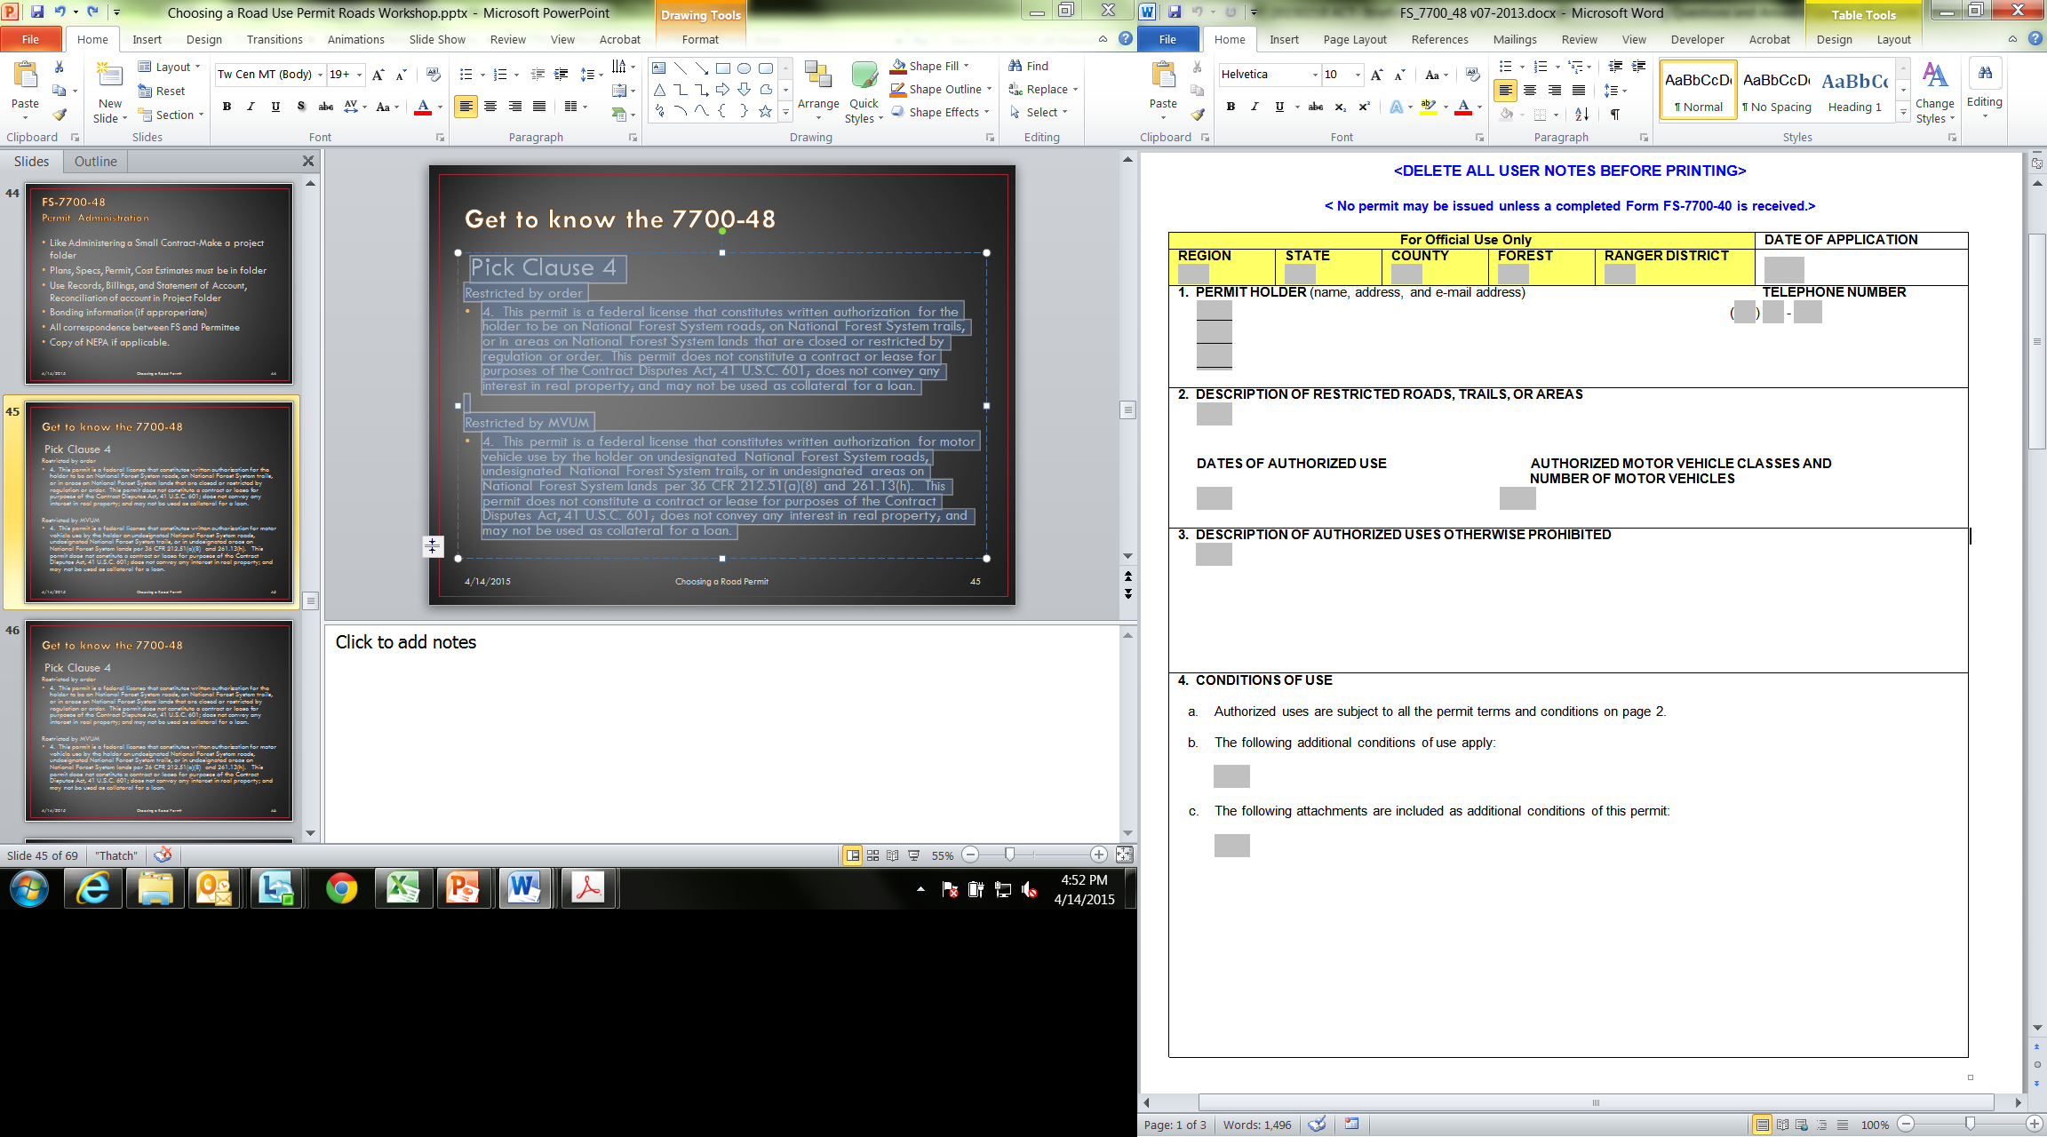
Get to know the 7700-48
Who
Information needs to be kept current
Unit information

Slide 47
Get to know the 7700-48
Where
Attach a map if appropriate
When
When are they allowed to be on the road
What
What type of vehicles are going to be on the road
How many vehicles

Slide 48
Get to know the 7700-48
What are you giving them a permit to do
Might not include everything asked for on the application

Slide 49
Get to know the 7700-48
Restrictions and conditions that apply to this permit
List of appendices
Maintenance requirements
Traffic Control
Other

Slide 50
Get to know the 7700-48
Pick Clause 4
Restricted by regulation or order
4. This permit is a federal license that constitutes written authorization for the holder to be on National Forest System roads, on National Forest System trails, or in areas on National Forest System lands that are closed or restricted by regulation or order. This permit does not constitute a contract or lease for purposes of the Contract Disputes Act, 41 U.S.C. 601; does not convey any interest in real property; and may not be used as collateral for a loan.
Restricted by MVUM
4. This permit is a federal license that constitutes written authorization for motor vehicle use by the holder on undesignated National Forest System roads, undesignated National Forest System trails, or in undesignated areas on National Forest System lands per 36 CFR 212.51(a)(8) and 261.13(h). This permit does not constitute a contract or lease for purposes of the Contract Disputes Act, 41 U.S.C. 601; does not convey any interest in real property; and may not be used as collateral for a loan.

Slide 51
Get to know the 7700-48
Carry a copy of the permit in the vehicle
Non-Exclusive Use
Just because you have a permit does not mean you can restrict access
Insurance requirements are the same as the 7700-41
Assignability
Not transferable
Renewal
Not Automatic
Holder needs to Re-apply prior to expiration

Slide 52
Permit for Use of Roads, Trails, or Areas Restricted by Regulation or Order FS-7700-48
QUESTIONS

Slide 53
When do I use a 7700-41 vs. 7700-48 for Non-federal Commercial Haul?
7700-41
7700-48
Longer term (1-5 years)
Multiple loads
Cost Recovery
Reconstruction
Commensurate Share
Investment Share
Performance bonding
More stringent insurance requirements
Shorter term or “one off”
Small number of loads
Minimal Maintenance
Low Risk
Environmental Damage
Public

Slide 54
When can I just write an Authorization Letter?
Does this involve a small number of trips?
Does the cost of issuing a form FS-7700-41or 7700-48 to authorize the commercial haul exceed the value of potential cost recovery and investment sharing (if appropriate)?
Are the risks of road or resource damage involved in authorizing the commercial hauling minimal?

Slide 55
When can I just write an Authorization Letter?
If the answer to ALL of those questions is YES then:
A letter signed by the responsible official may be issued to authorize the commercial hauling
Reference: FSM 7731.17

Slide 56
Incidental Commercial Use… Build you own tool…
Consider a local order that allows exemptions for incidental use
“The occasional delivery of fuel, food, and other necessary supplies, or provision of services”
Where is the Line?
Line Officer Discretion
Work closely with Law Enforcement
Notes:
One way to look at it – Where does the commercial activity originate?
:
Logs coming off Private to go to the mill →commercial use
Logs coming on to private for fuelwood or building materials →incidental use
Fuels coming off private → oil and gas permit
Fuels truck delivering propane →incidental use
But…. There is always discretion if the activity will cause damage to forest resources. Such as:
Time of year may damage road
Haul would conflict with recreation traffic (say Labor Day weekend)
Other?

Slide 57
Oversized and Overweight Permits

Slide 58
Oversized and Overweight Permits
Should be applied for using the 7700-40 and 7700-40b
Should be issued separately from any Commercial Use Permits
Do not use a long-term permit to preserve or guarantee oversized rights for future use, conditions change
Notes:
Each Region may have a different way of reviewing this application for this type of permit.
Do not use a long-term permit to preserve or guarantee oversized rights for future use, conditions change.

Slide 59
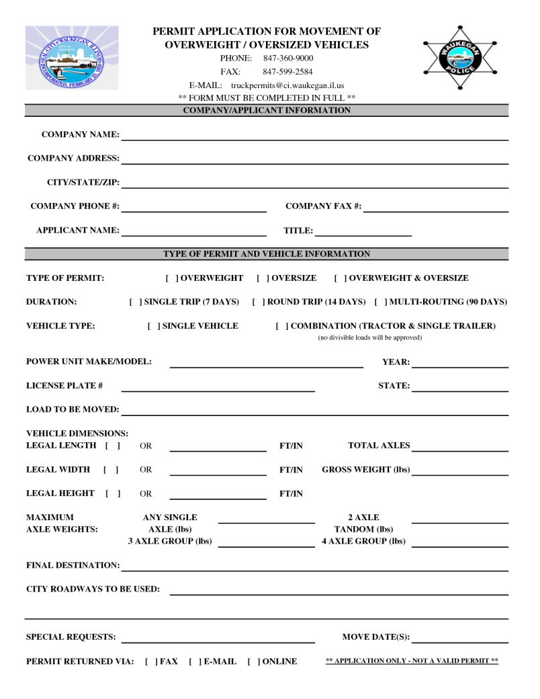
FS 7700-0040b Oversize Vehicle Attachment
Example State Application
or
A State Overweight permit application is also acceptable to use providing it has all of the information needed on page one of the FS-7700-0040b
Notes:
Oversize Vehicle Attachment 7700-40b
Handout Attachment b (it is linked in this slide) Also handout State Application for Overload
Page one is completed by the applicant*
Reason for permit
Is it associated with a contract?
Desired Travel Dates and Routes
When are they planning on hauling
Road Numbers and any bridges crossed
Helpful if its shown on a map
Vehicle Information
*A State Overload permit application is also acceptable to use providing it has all of the information needed on page one of the attachment b.

Slide 60
Oversized and Overweight Permits
Required for loads :
Exceeding State Law
Exceeding Forest limits established by order
Exceeding posted limits on bridges or other structures
Notes:
Check with your Bridge Inspection Program Manager for information specific to your region for information on Overload permits.
See FSM 7731.18, FSM 7736.42, and FSH 7709.56b, chapter 90, section 92 for additional guidance regarding road use permits for oversize vehicle movements.
When the use of NFS roads by vehicles exceeding highway legal size and weight limits is authorized by easements or other valid outstanding rights, follow procedures for off-highway haul in FSM 7731.18
While the FS-7700-40 is always required, National or regional standard Forest Service forms or forms developed by state departments of transportation may be used for permits.
The overload permit must describe the features of the vehicle and its load and must specify the allowable travel route. Overload permits must be issued in accordance with FSM 7736.42.
The Forest Supervisor, with the concurrence of the Bridge Inspection Program Manager, is responsible for issuing overload permits

Slide 61
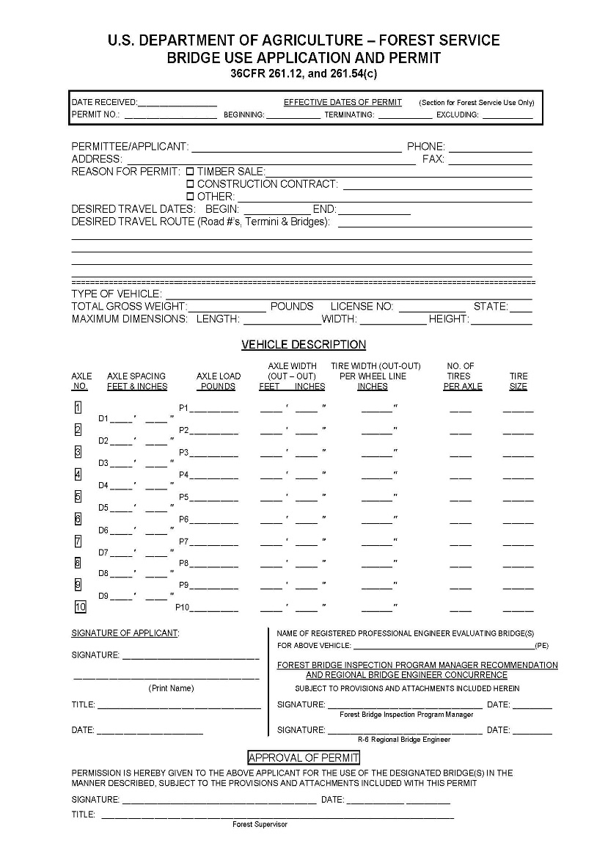
Bridge Overweight Permits
Issue separately from other permits
You can use the FS-7700-48 or a locally developed form
Signed by the Forest Supervisor with concurrence of the Bridge Inspection Program Manager
Notes:
Issue bridge overweight permits separately from other road use permits (see Forms FS-7700-40, Application for Road Use Permit, and FS-7700-48, Road Use Permit).
While the FS-7700-40 is always required, National or regional standard Forest Service forms or forms developed by state departments of transportation may be used for permits.
The overweight permit must describe the features of the vehicle and its load and must specify the allowable travel route. Overweight permits must be issued in accordance with FSM 7736.42.
The Forest Supervisor, with the concurrence of the Bridge Inspection Program Manager, is responsible for issuing overload permits

Slide 62
Questions on Selection of Permits?

Slide 63
What Kind of Engineering Road Use Permit
SCENARIO TIME

Slide 64
Scenario 1
A forest user has reserved a group campsite for a wedding. The NFS road is an objective maintenance level 3 open to the public but is currently operated as a maintenance level 2. The forest user would like to have the road bladed right before the wedding so the guests can drive their cars to the site.

Slide 65
Scenario 2
There is a piece of private land that is accessed from a NFS road. The NFS Road is currently open to the public and is at an objective and operational maintenance level 3. The owner plans to log 10 MBF. The two truckloads of logs will be hauled to mill over this NFS road.

Slide 66
Scenario 3
A privately owned parcel is accessed by two different NFS roads. One of the roads is open year road to the public and is the main access to his parcel. The other road has a seasonal closure on it from October 15th to Dec 30th. The owner needs to access the back side of his property to do some work on an old well in November. The best way to access the well is using the road with the seasonal closure.

Slide 67
Scenario 5
A private land owner has a Private Road Special Use Permit on the road accessing his property. He will be logging several acres over a 5 year period. The estimated timber volume is 100 MBF total. The haul route for all of the volume is on the road with the Private Road Special Use Permit then onto a NFS road before it reaches the county road.

Slide 68
Scenario 6
A cabin owner is going to build a deck. He is having 1 load of lumber being delivered. The delivery truck will have to use an NFS road.

Slide 69
Scenario 7
A property owner is building a deluxe cabin. All of the construction materials will be delivered to the property on a NFS road.

Slide 70
Scenario 8
A timber sale requires a yarder at the landing. The access route to the landing is via an NFS road with two bridge crossings.

Slide 71
Scenario 9
The local Boy Scout camp is hosting a school field trip. They have requested access to use a large school bus on a NFS road that accesses the camp.

Slide 72
Scenario 11
A volunteer group would like to do maintenance on a NFS road leading to their favorite trail. The group would like to do road side brushing, logging out with chainsaws and filling in pot holes for a smoother ride.
Notes:
36CFR261.10 says that no one can construct or maintain a forest service road without some form of written authorization like a contract, agreement, or permit. So even the volunteer work would need to be authorized unless the proposed use will have such nominal effects on National Forest System lands, resources, or programs that it is not necessary to establish terms and conditions.

Slide 73
Permit for Use of Roads, Trails, or Areas Restricted by Regulation or Order FS-7700-48
EXAMPLE TIME

Slide 74
Questions on the Permit Selection?

